Slide 1
Chapter 05
Knowledge Sharing

Slide 2
Objectives
The Social Nature of Knowledge
Knowledge Networks
Sociograms and Social Network Analysis
Knowledge-Sharing Communities
Types of Communities

Slide 3
Objectives (con’t)
Obstacles to Knowledge Sharing
Organizational Learning and Social Capital
Strategic Implications of Knowledge Sharing
Practical Implications of Knowledge Sharing

Slide 4
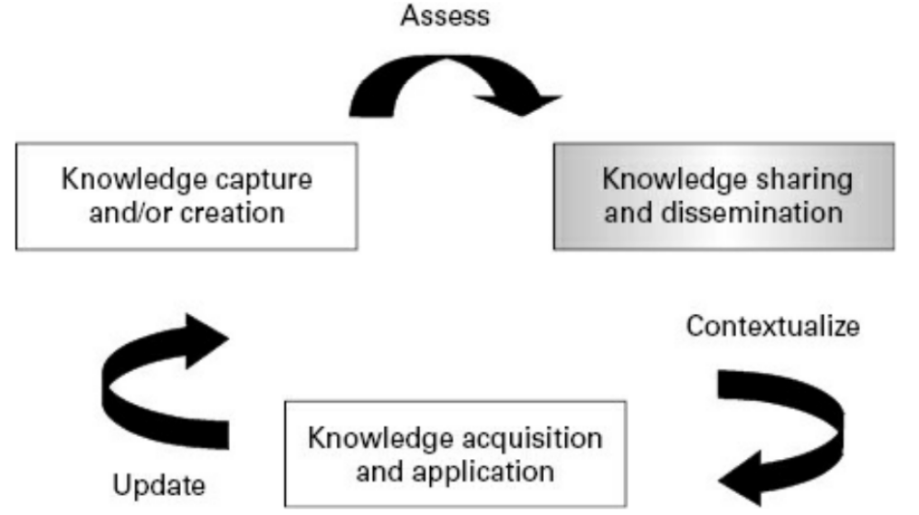

Introduction
Once knowledge has been captured and codified, it needs to be shared and disseminated throughout the organization
Information-based approaches focus primarily on knowledge capture and codification. The information-based approach tends to emphasize explicit knowledge rather than tacit and favors the externalization objective.

Slide 5
The Social Nature of Knowledge
Knowledge management needs to view knowledge as something that is actively constructed in a social setting (McDermott, 2000).
Group members produce knowledge by their interactions, and a group memory is created.
Social constructivism views knowledge not as an objective entity but as a subjective, social artifact (Berger and Luckmann, 1966).

Slide 6
Knowledge Networks
Pugh and Prusak (2013) further identified eight key dimensions of knowledge networks that span strategic, structural, and tactical organizational levels:
    1. Leader’s theory of change
    2. Objectives, outcomes, and purpose
    3. Role of expertise and experimental learning
    4. Inclusion and participation
    5. Operating model
    6. Structures and infrastructures
    7. Facilitation and social norm development
    8. Measurement, feedback, and incentives

Slide 7
Knowledge Networks
The term “community of practice” (CoP) is being replaced by the label “knowledge network” (KN).
Communities of Practice (CoPs) are working to strengthen public health as members learn, share expertise, and work together on solving common problems in their communities’ focus areas.
Social network analysis (SNA) is the mapping and measuring of relationships and flows between people, groups, organizations, computers, or other information/knowledge processing entities (Krebs, 2000).

Slide 8
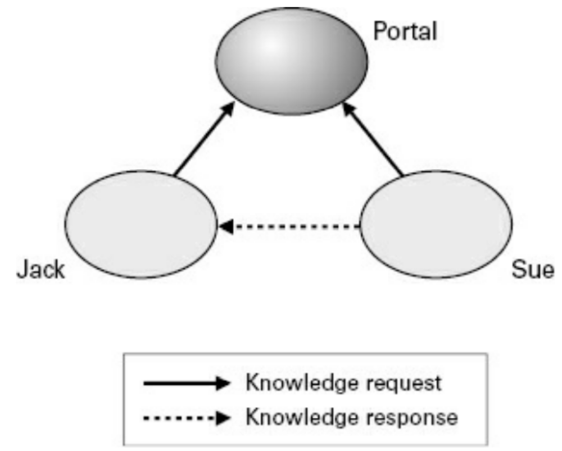
Sociograms and Social Network Analysis
SNA can map and measure relationships and flows between people, groups, organizations, computers, or other information/knowledge processing entities.

Slide 9
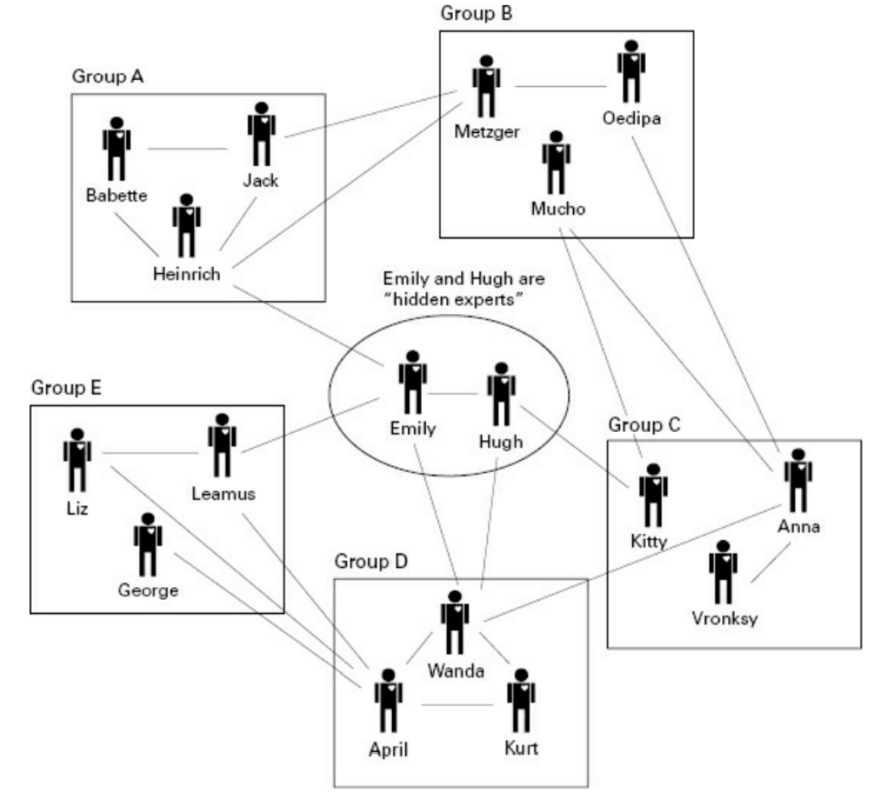
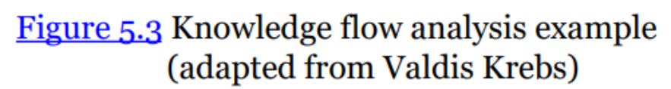
Sociograms and Social Network Analysis

Slide 10
Sociograms and Social Network Analysis
Key stages of the process will typically include:
  Identifying the network of people to be analyzed (e.g., team, workgroup, department).
  Clarifying objectives and formulating hypotheses and questions.
  Developing the survey methodology and designing the questionnaire.
  Surveying the individuals in the network to identify the relationships and knowledge flows between them.

Slide 11
Sociograms and Social Network Analysis
Key stages of the process will typically include (con’t):
  Using a software mapping tool to visually map out the network.
  Analyzing the map and the problems and opportunities highlighted using interviews and/or workshops.
  Designing and implementing actions to bring about desired changes.
  Mapping the network again after a suitable period of time.

Slide 12
Sociograms and Social Network Analysis
It is important to know what information you need to gather in order to build a relevant picture of your group or network.
Good survey design and questionnaire design are therefore key considerations.

Slide 13
Sociograms and Social Network Analysis
Questions will be typically based on factors such as:
Who knows who and how well?
How well do people know each other’s knowledge and skills?
Who or what gives people information about xyz?
What resources do people use to find information/feedback/ideas/advice about xyz?
What resources do people use to share information about xyz?

Slide 14
Knowledge-Sharing Communities
Although technology is a feature of some communities, technological means of interacting are not a necessary component of communities. Technology comes into play when members are more dispersed and when they have fewer occasions to meet face to face. The critical components of a community lie in the sharing of common work problems between members, a membership that sees the clear benefits of sharing knowledge among themselves and that has developed norms of trust, reciprocity, and cooperation.

Slide 15
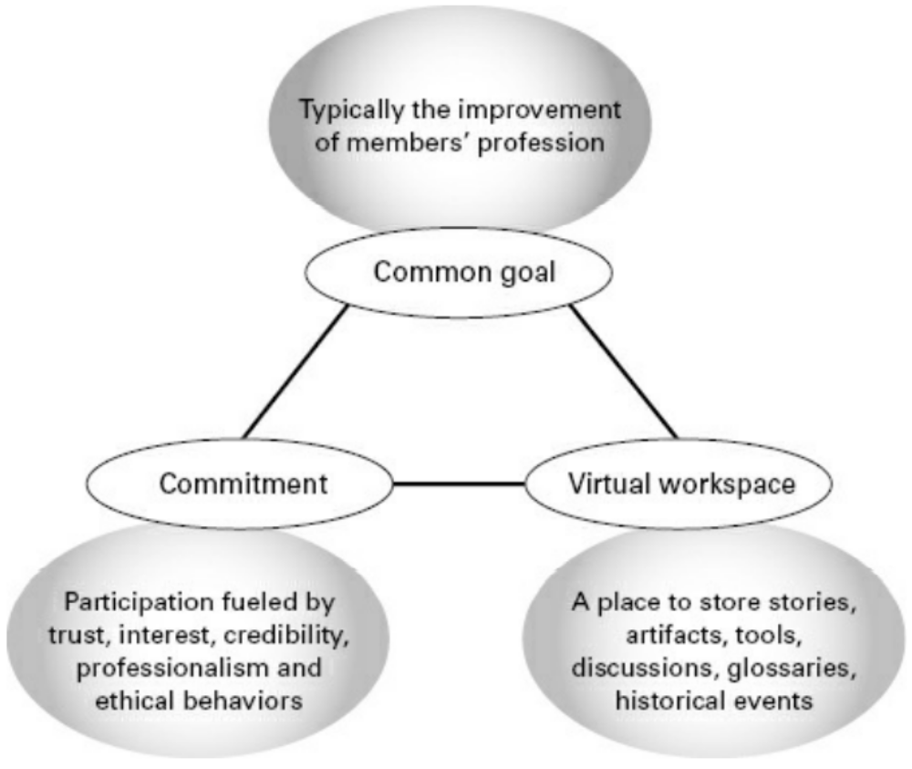
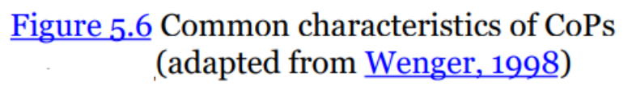
Types of Communities
All communities share some basic characteristics, regardless of the type of community. Wenger (1998) identifies these characteristics as joint enterprise, mutual engagement, and shared repertoire

Slide 16
Types of Communities
There are many types of CoPs, and they are typically defined as a function of some common focal points such as:
  A profession such as engineering, law, or medicine.
  A work-related function or process such as production, distribution, marketing, sales, and customer service.
  A recurring, nagging problem situated in a process or function.
  A topic such as technology, knowledge retention, or innovation.
  An industry such as automotive, banking, or healthcare.

Slide 17
Types of Communities
Roles and Responsibilities in CoPs
The major CoP roles include a champion, a sponsor, a facilitator, a practice leader, a knowledge service center or office (KSO), and members.
The champion ensures support at the highest possible level, communicates the purpose, promotes the community, and ensures impact.

Slide 18
Types of Communities
Roles and Responsibilities in CoPs (con’t)
The sponsor serves as the bridge between the CoP and the rest of the formal organization, communicates the company’s support for a CoP, and may remove barriers such as time, funding, and other resources. The sponsor is instrumental in establishing the mission and expected outcomes for the community.
Community members are recruited for their expertise relevant to the practice or strategic services. They are there to better share knowledge, know-how, and best practices that will benefit the business through active participation.

Slide 19
Types of Communities
Roles and Responsibilities in CoPs (con’t)
CoP facilitators have perhaps the most demanding role.
CoP knowledge services are information/knowledge integrators who serve to interface with all CoPs to ensure clarity and lack of duplication of the information disseminated within and from the CoPs.

Slide 20
Obstacles to Knowledge Sharing
A number of obstacles can hinder knowledge sharing within organizations.
Chief among these obstacles is the notion that knowledge is property and ownership is very important. One of the best ways to counteract this notion is to reassure individuals that authorship and attribution will be maintained. In other words, they will not lose the credit for a knowledge product they created. Maintaining the connection between knowledge and the people who are knowledgeable about it is paramount in any knowledge management system.

Slide 21
Obstacles to Knowledge Sharing
There is a prevalent notion of knowledge as power. The more that information is shared between individuals, the more opportunities for knowledge creation occur.
The Undernet
The undernet is often referred to as KM’s dirty little secret: however much you invest in high-tech knowledge banks, employees in search of an answer tend to make their first port of call the folks they know from the water cooler.

Slide 22
Organizational Learning and Social Capital
Human capital refers to a person’s education, skills, and background necessary to be productive in an organization or profession.
Social capital has been coined to refer to the institutions, relationships, and norms that shape the quality and quantity of an organization’s social interactions

Slide 23
Organizational Learning and Social Capital
Measuring the Value of Social Capital
Organizations have begun to implement a large number of communities of practice in hopes of achieving such benefits as:
Building loyalty and commitment among stakeholders.
Promoting innovation through better sharing of best practices.
Improving efficiency of processes.
Generating greater revenue and revenue growth.
Decreasing employee turnover and attrition.

Slide 24
Strategic Implications of Knowledge Sharing
Some of the strategically important benefits of knowledge sharing include:
Connecting professionals across platforms, across distances.
Standardizing professional practices.
Avoiding mistakes.
Leveraging best practices.
Reducing time to talent.
Reducing time to talent.
Building reputation.
Taking on stewardship for strategic capabilities.

Slide 25
Practical Implications of Knowledge Sharing
It is important that knowledge-sharing interactions be maintained at a professional level at all times and that all members of a virtual network be aware of and agree to adhere to a professional code of ethics, both online and offline.

Slide 26
Summary
Describe the key components of a community of practice. The major differences between a team, a knowledge network, and a community of practice.
Outline the major phases in the life cycle of a community and the corresponding information and knowledge management needs for each.
Define the major roles and responsibilities in a community of practice.

Slide 27
Summary (con’t)
Characterize knowledge sharing channels with respect to the dimensions of social presence and media richness.
Analyze the flow of knowledge in a community of practice using appropriate tools and techniques to identify enablers and obstacles to knowledge sharing.
Tools and technologies are used in collaboration.

Slide 28

Discussion / Homework / Team Activities
Compare and contrast some different types of communities of practice. Describe how they would differ with respect to their goals.
What are some of the key deterrents to knowledge sharing and knowledge flow within an organization? How could you help overcome them?
List some of the ways in which social network analysis techniques can be used to better understand how knowledge is circulated within an organization.
What are some popular technologies used to support knowledge networks and communities of practice? How do they compare? When would it be beneficial to use what tool? How would you make your decision?
What are some of the key steps you would need to carry out in order to conduct a social network analysis of an organization?

